Slide 1
Internet & Web
Lab 7: Internet

Slide 2


Welcome to Internet & Web Class

Slide 3

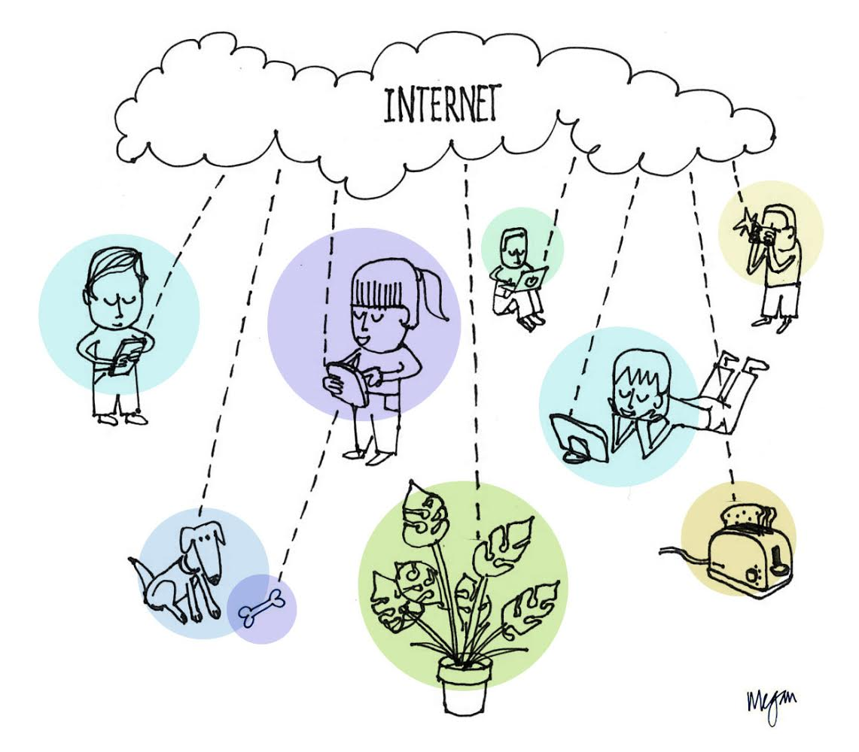
Internet
A global wide area network
that connects millions of
computer systems across the
world.

Slide 4
Internet Fact
Introduced by ARPA as ARPANet at 1969
190+ country are connected
Can connect to Internet through ISP

Slide 5
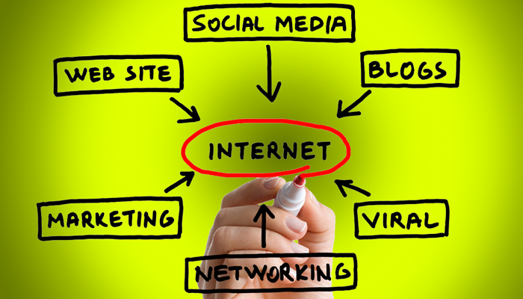
Frequent Online Services by Internet
Web.
Email.
Social Media.
Online Gaming.
Software Support.

Slide 6
Benefits of Internet
Electronic Communications
Online Shopping
Online Banking
Information Gathering and learning
Connectivity, communication, and sharing
News
Globalization
Social Networking
Marketing.

Slide 7
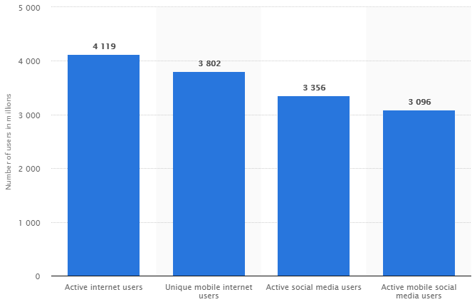
Global Internet User

Slide 8
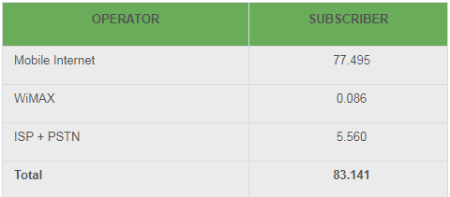
Local Internet User

Slide 9

Today’s learning:
Internet & Its Origin
Service, Benefits of Internet
Internet Users.
Thank You!

